Slide 1

Introduction to Operating Systems CS 1550
Spring 2022
Sherif Khattab
ksm73@pitt.edu
(Some slides are from Silberschatz, Galvin and Gagne ©2013)

Slide 2
Announcements
Upcoming deadlines:
Quiz 2: due on 3/25
Homework 9: due on 3/28
Lab 3: due on 4/1
Project 3: due on 4/11

Slide 3
Previous Lecture …
Tracing page replacement algorithms
FIFO and CLOCK
LRU and OPT

Slide 4
Muddiest Points
Do page evictions happen across processes?

Slide 5
Local vs. global allocation policies
What is the pool of pages eligible to be replaced?
Pages belonging to the process needing a new page
All pages in the system
Local allocation: replace a page from this process
May be more “fair”: penalize processes that replace many pages
Can lead to poor performance: some processes need more pages than others
Global allocation: replace a page from any process
Last access time
Page
A0
14
A1
12
Local allocation
A2
8
A3
A4
5
A4
B0
10
B1
9
Global allocation
B2
A4
3
C0
16
C1
12
C2
8
C3
5
C4
4

Slide 6
Muddiest Points
what measures do modern operating systems take in order to minimize thrashing?

Slide 7
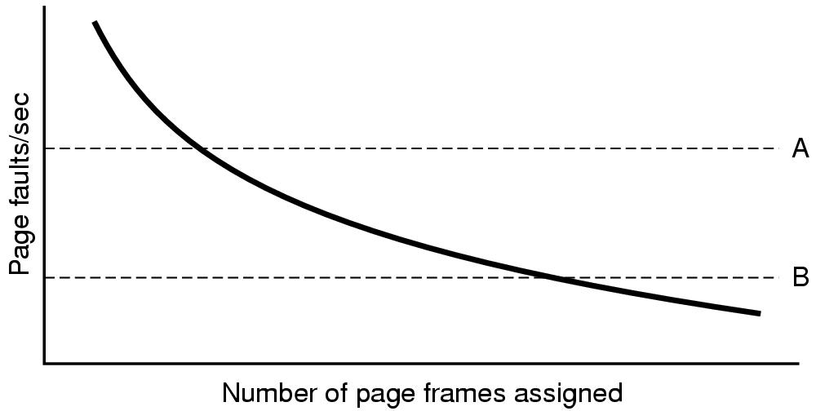
Page fault rate vs. allocated frames
Local allocation may be more “fair”
Don’t penalize other processes for high page fault rate
Global allocation is better for overall system performance
Take page frames from processes that don’t need them as much
Reduce the overall page fault rate (even though rate for a single process may go up)

Slide 8
Control overall page fault rate
Despite good designs, system may still thrash
Most (or all) processes have high page fault rate
Some processes need more memory, …
but no processes need less memory (and could give some up)
Problem: no way to reduce page fault rate
Solution : Reduce number of processes competing for memory
Swap one or more to disk, divide up pages they held
Reconsider degree of multiprogramming

Slide 9

Backing up an instruction
Problem: page fault happens in the middle of instruction execution
Some changes may have already happened
Others may be waiting for VM to be fixed
Solution: undo all of the changes made by the instruction
Restart instruction from the beginning
This is easier on some architectures than others
Example: LW R1, 12(R2)
Page fault in fetching instruction: nothing to undo
Page fault in getting value at 12(R2): restart instruction

Slide 10
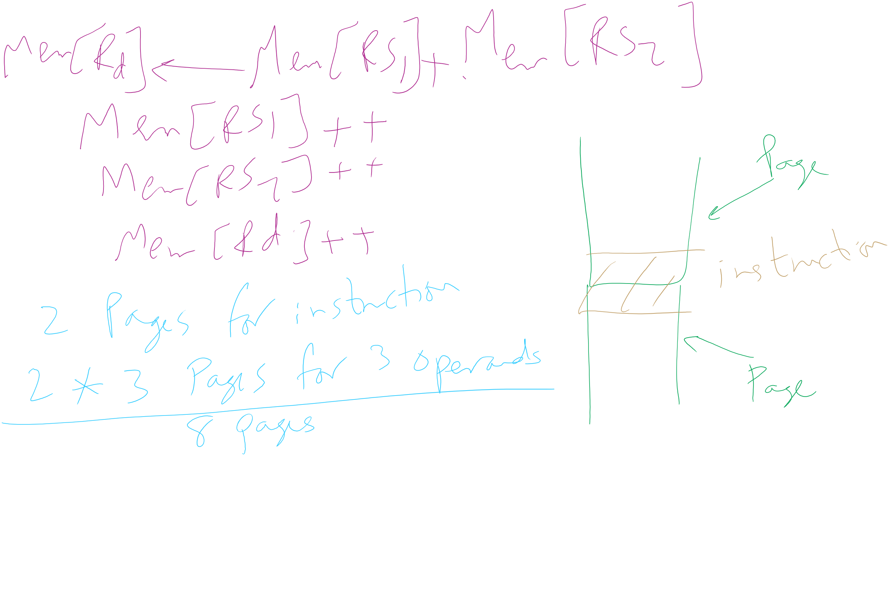
Minimum memory allocation to a process
Example: ADD (Rd)+,(Rs1)+,(Rs2)+
Page fault in writing to (Rd): may have to undo an awful lot…

Slide 11
Muddiest Points
What is disk write?
What does the * mean?
CLOCK
When does the orbit (or bit?) change in the clock simulation (FIFO/slide 14)
how does the clock iterate in the example from class?
LRU
Determining page faults in LRU modelling
How to calculate the distance
Is there a way to easily determine the disk writes using the LRU stack algorithm?
Would you please solve some example for LRU and OPT? Thank you so much

Slide 12
Muddiest Points
How the tracing changes between different types of scheduling
FIFO
why does FIFO have more page faults with more memory (small explanation?)?
How to implement stack algorithm in code

Slide 13
Muddiest Points
how to keep track of larger tables that can store more pages.
Problem of the Day!

Slide 14
Separating policy and mechanism
Mechanism for page replacement has to be in kernel
Modifying page tables
Reading and writing page table entries
Policy for deciding which pages to replace could be in user space
More flexibility
3. Request page
User process
External pager
4. Page arrives
User space
2. Page needed
5. Here is page!
Kernel space
Fault handler
MMU handler
1. Page fault
6. Map in page

Slide 15
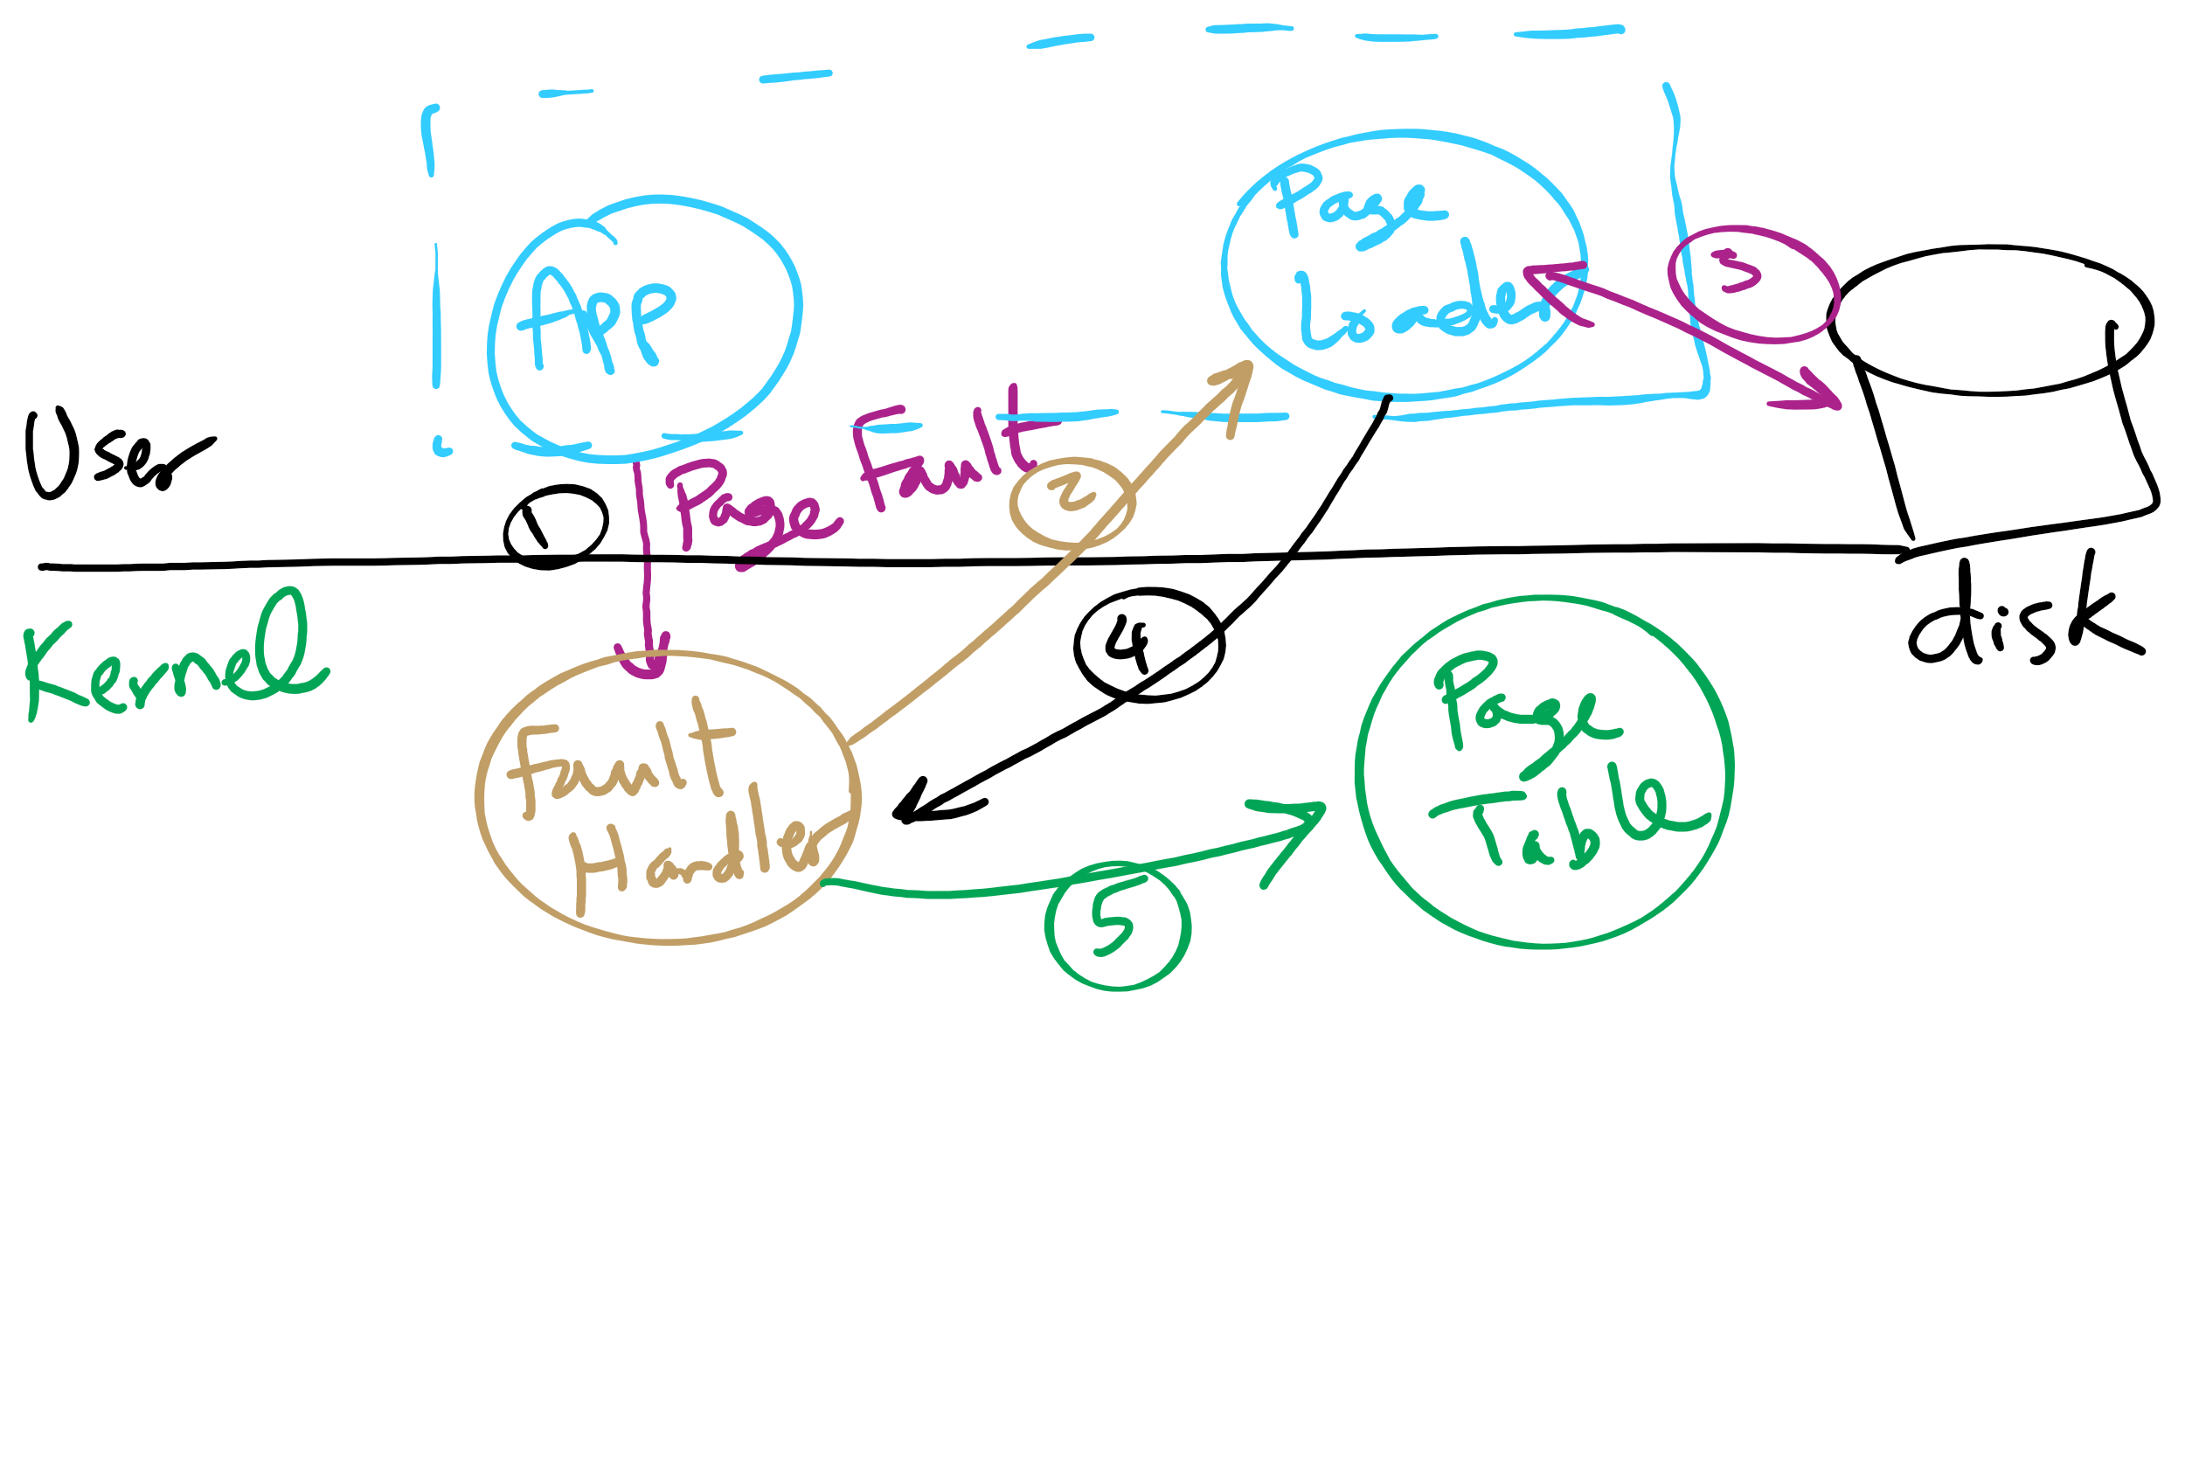
Separating Policy and Mechanism for Page Replacement

Slide 16
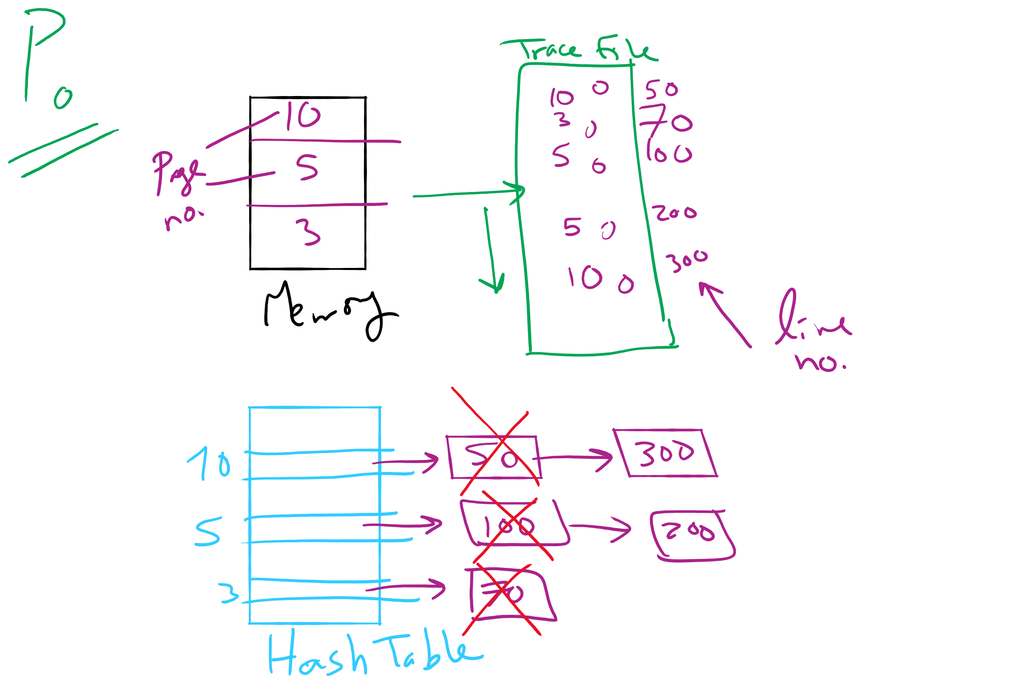
Project 3: OPT Simulation

Slide 17
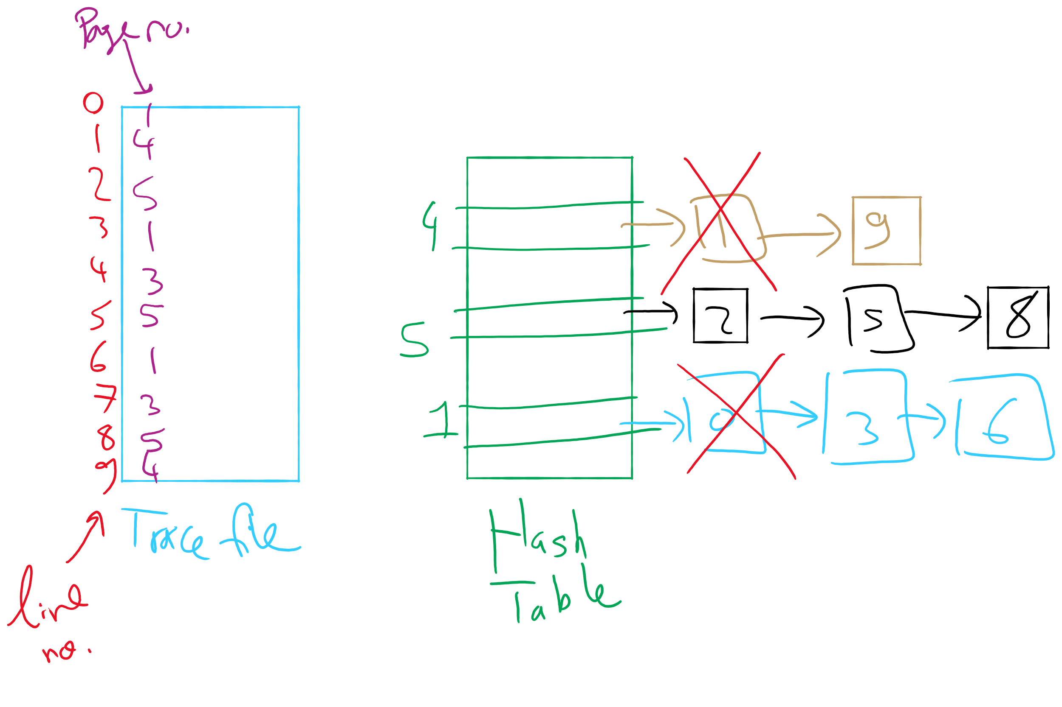
OPT Implementation Example

Slide 18

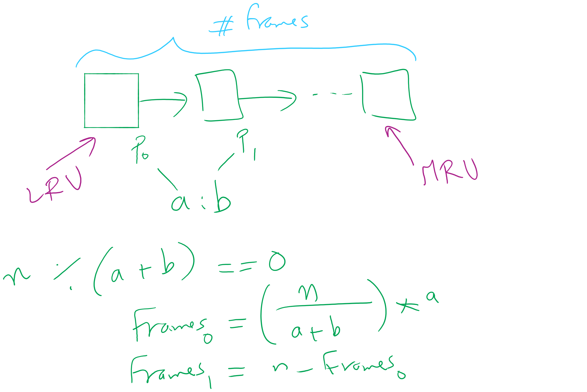
Project 3: LRU and miscellaneous hints

Slide 19
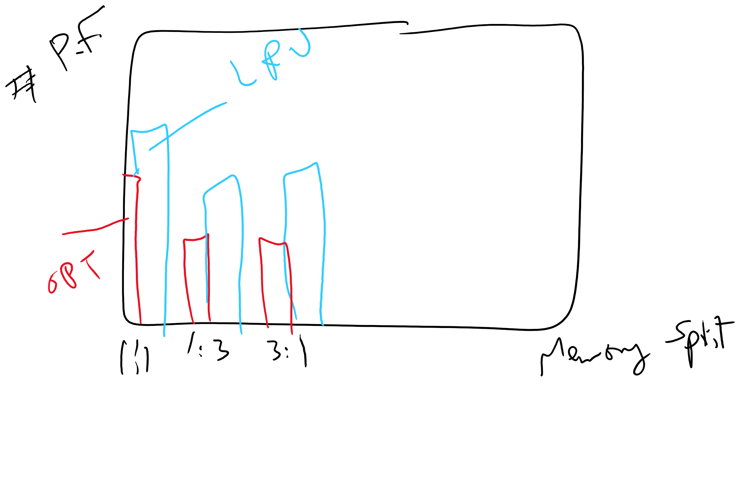
Project 3: Writeup hints

Slide 20
Problem of the Day
How to keep track of larger page tables that can store more pages
How big can a page table be?
64-bit machine
4 KB page size
How many pages?
How many PTE?
How big is a PTE?
How big is the page table of one process?

Slide 21
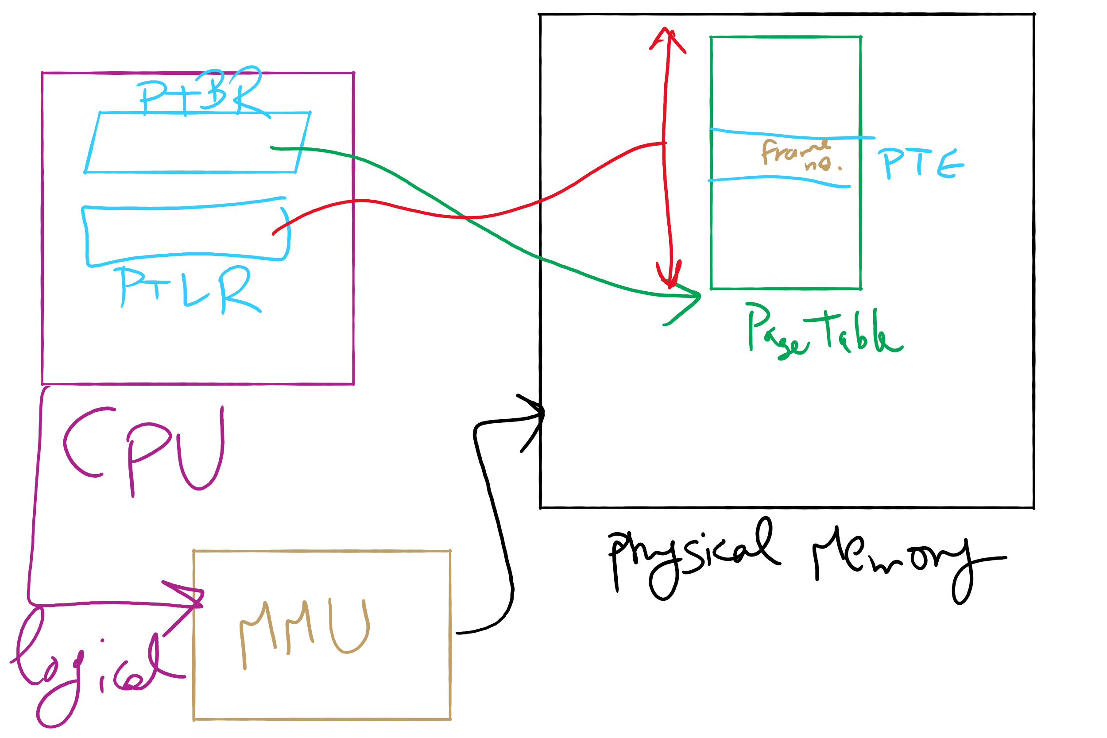
Address Translation Structures

Slide 22
Memory & paging structures
Physical memory
Page frame number
Page 0
6
Page 1
3
0
Page 1 (P1)
Page 2
4
1
Page 3
9
2
Page 4 (P0)
Page 4
2
3
Page 1 (P0)
Free
pages
4
Page 2 (P0)
Logical memory (P0)
Page table (P0)
5
6
Page 0 (P0)
Page 0
8
7
Page 1
0
8
Page 0 (P1)
9
Page 3 (P0)
Logical memory (P1)
Page table (P1)

Slide 23
Mapping logical => physical address
Split address from CPU into two pieces
Page number (p)
Page offset (d)
Page number
Index into page table
Page table contains base address of page in physical memory
Page offset
Added to base address to get actual physical memory address
Page size = 2^{d} bytes
Example:
• 4 KB (=4096 byte) pages
• 32 bit logical addresses
2^{d} = 4096
d = 12
32-12 = 20 bits
12 bits
p
d
32 bit logical address

Slide 24
Address translation architecture
page number
Page frame number
Page frame number
page offset
0
CPU
p
d
f
d
1
. . .
0
f-1
1
f
. . .
f+1
p-1
f+2
p
f
. . .
p+1
physical memory
page table

Slide 25
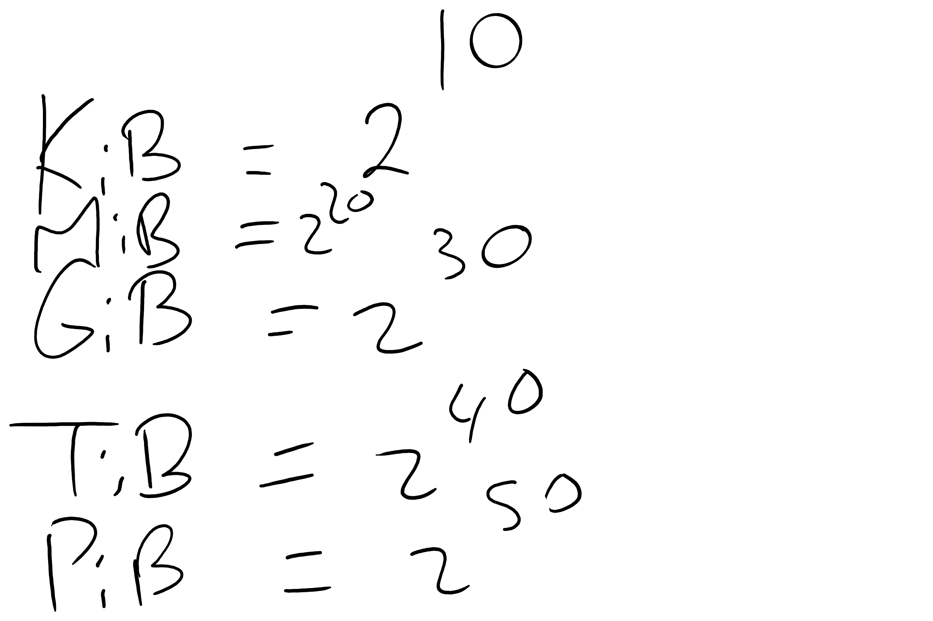
Memory Sizes

Slide 26
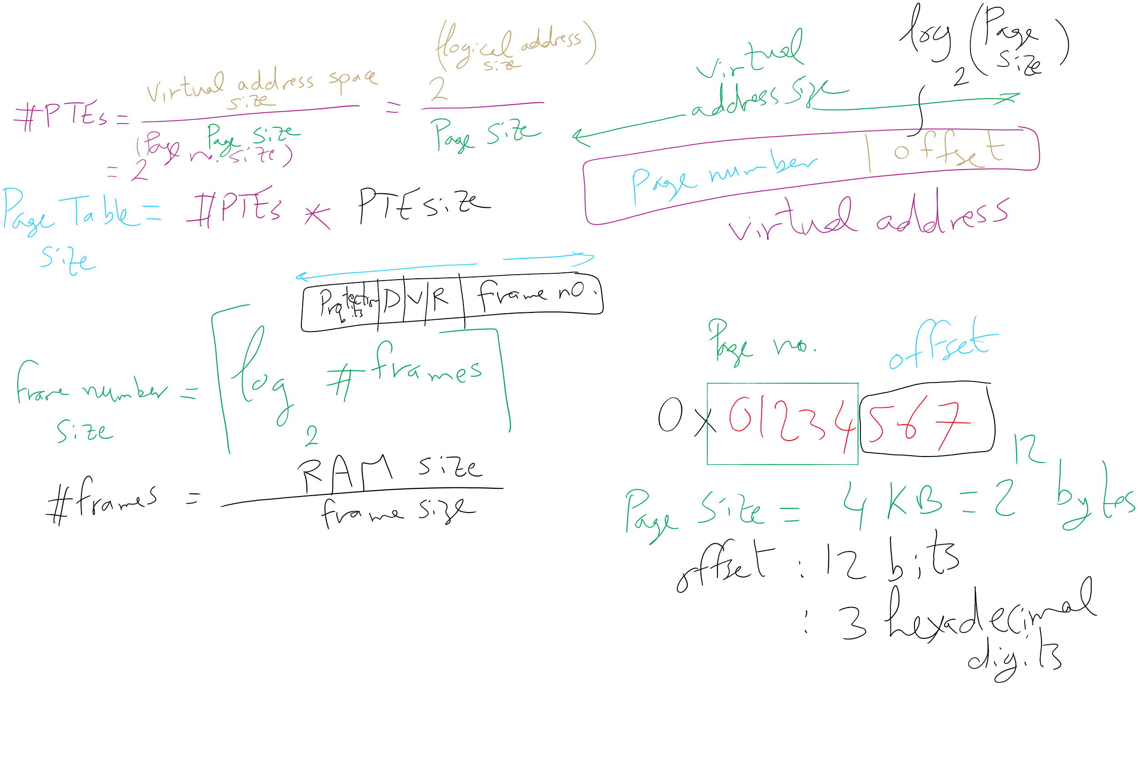
Address Translation Relations

Slide 27
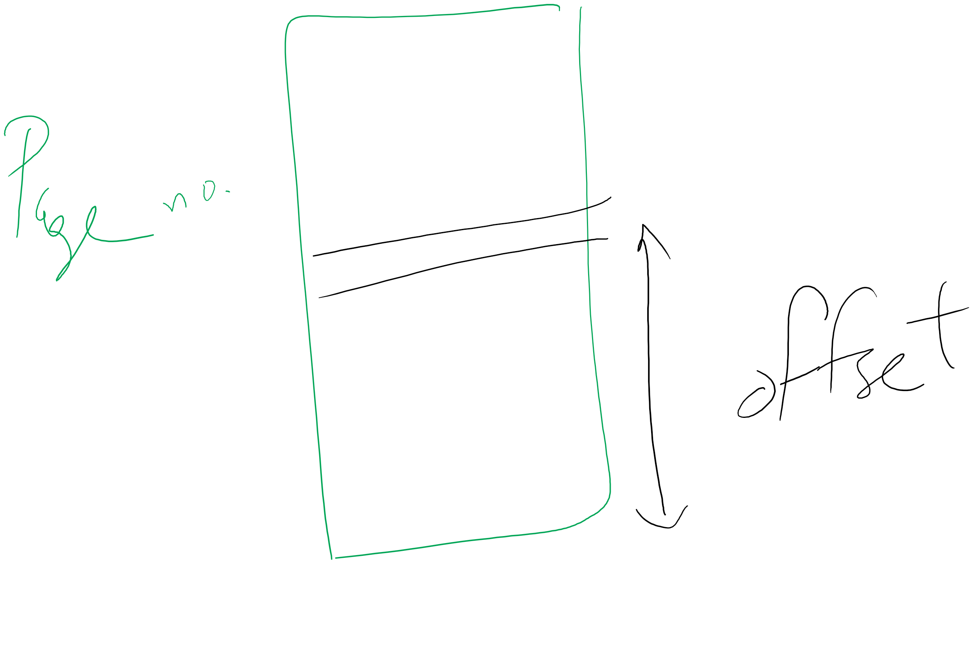
Page number vs. Offset

Slide 28
Solution 1: Two-level page tables
Problem: page tables can be too large
2³² bytes in 4KB pages need 1 million PTEs
Solution: use multi-level page tables
“Page size” in first page table is large (megabytes)
PTE marked invalid in first page table needs no 2nd level page table
1st level page table has pointers to 2nd level page tables
2nd level page table has actual physical page numbers in it
. . .
220
. . .
657
. . .
. . .
401
. . .
. . .
. . .
125
613
. . .
. . .
. . .
1st level page table
961
. . .
884
960
. . .
2nd level page tables
. . .
main memory
955

Slide 29
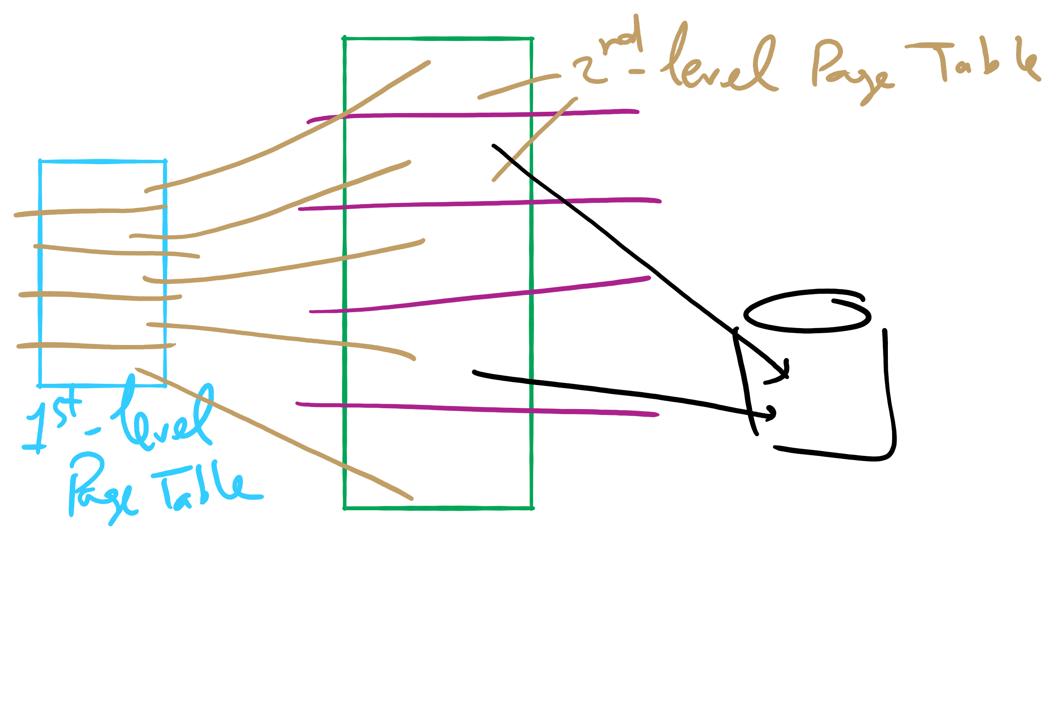
Two-level Page Table

Slide 30
More on two-level page tables
Tradeoffs between 1st and 2nd level page table sizes
Total number of bits indexing 1st and 2nd level table is constant for a given page size and logical address length
Tradeoff between number of bits indexing 1st and number indexing 2nd level tables
More bits in 1st level: fine granularity at 2nd level
Fewer bits in 1st level: maybe less wasted space?
All addresses in table are physical addresses
Protection bits kept in 2nd level table

Slide 31
Two-level paging: example
System characteristics
8 KB pages
32-bit logical address divided into 13 bit page offset, 19 bit page number
Page number divided into:
10 bit page number
9 bit page offset
Logical address looks like this:
p₁ is an index into the 1st level page table
p₂ is an index into the 2nd level page table pointed to by p₁
page number
page offset
p₁ = 10 bits
p₂ = 9 bits
offset = 13 bits

Slide 32
2-level address translation example
page number
page offset
p₁ = 10 bits
p₂ = 9 bits
offset = 13 bits
frame number
0
Page table base
physical address
1
0
19
13
. . .
1
. . .
0
1
p₁
. . .
. . .
. . .
p₂
main memory
1st level page table
. . .
2nd level page table

Slide 33
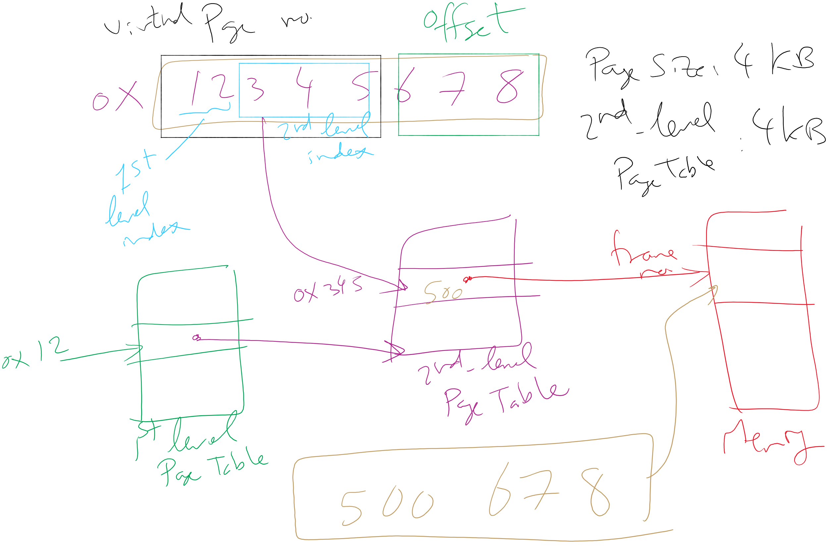
Address Translation: 2-level Page Table

Slide 34
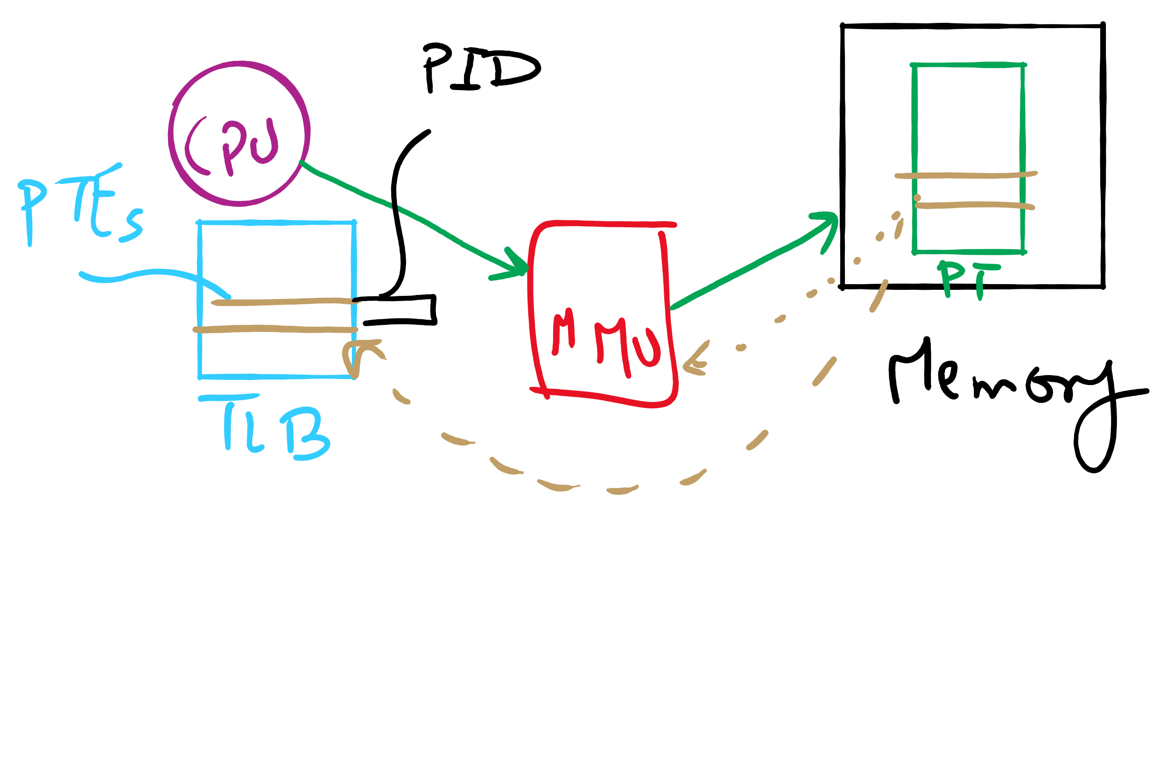
TLB

Slide 35
Translation Lookaside Buffer (TLB)
Search the TLB for the desired logical page number
Search entries in parallel
Use standard cache techniques
If desired logical page number is found, get frame number from TLB
If desired logical page number isn’t found
Get frame number from page table in memory
Replace an entry in the TLB with the logical & physical page numbers from this reference
Logical page #
Physical frame #
8
3
unused
2
1
3
0
12
12
29
6
22
11
7
4
Example TLB

Slide 36
Handling TLB misses
If PTE isn’t found in TLB, OS needs to do the lookup in the page table
Lookup can be done in hardware or software
Hardware TLB replacement
CPU hardware does page table lookup
Can be faster than software
Less flexible than software, and more complex hardware
Software TLB replacement
OS gets TLB exception
Exception handler does page table lookup & places the result into the TLB
Program continues after return from exception
Larger TLB (lower miss rate) can make this feasible

Slide 37
How long do memory accesses take?
Assume the following times:
TLB lookup time = a (often zero - overlapped in CPU)
Memory access time = m
Hit ratio (h) is percentage of time that a logical page number is found in the TLB
Larger TLB usually means higher h
TLB structure can affect h as well
Effective access time (an average) is calculated as:
EAT = (m + a)h + (m + m + a)(1-h)
EAT =a + (2-h)m
Interpretation
Reference always requires TLB lookup, 1 memory access
TLB misses also require an additional memory reference

Slide 38
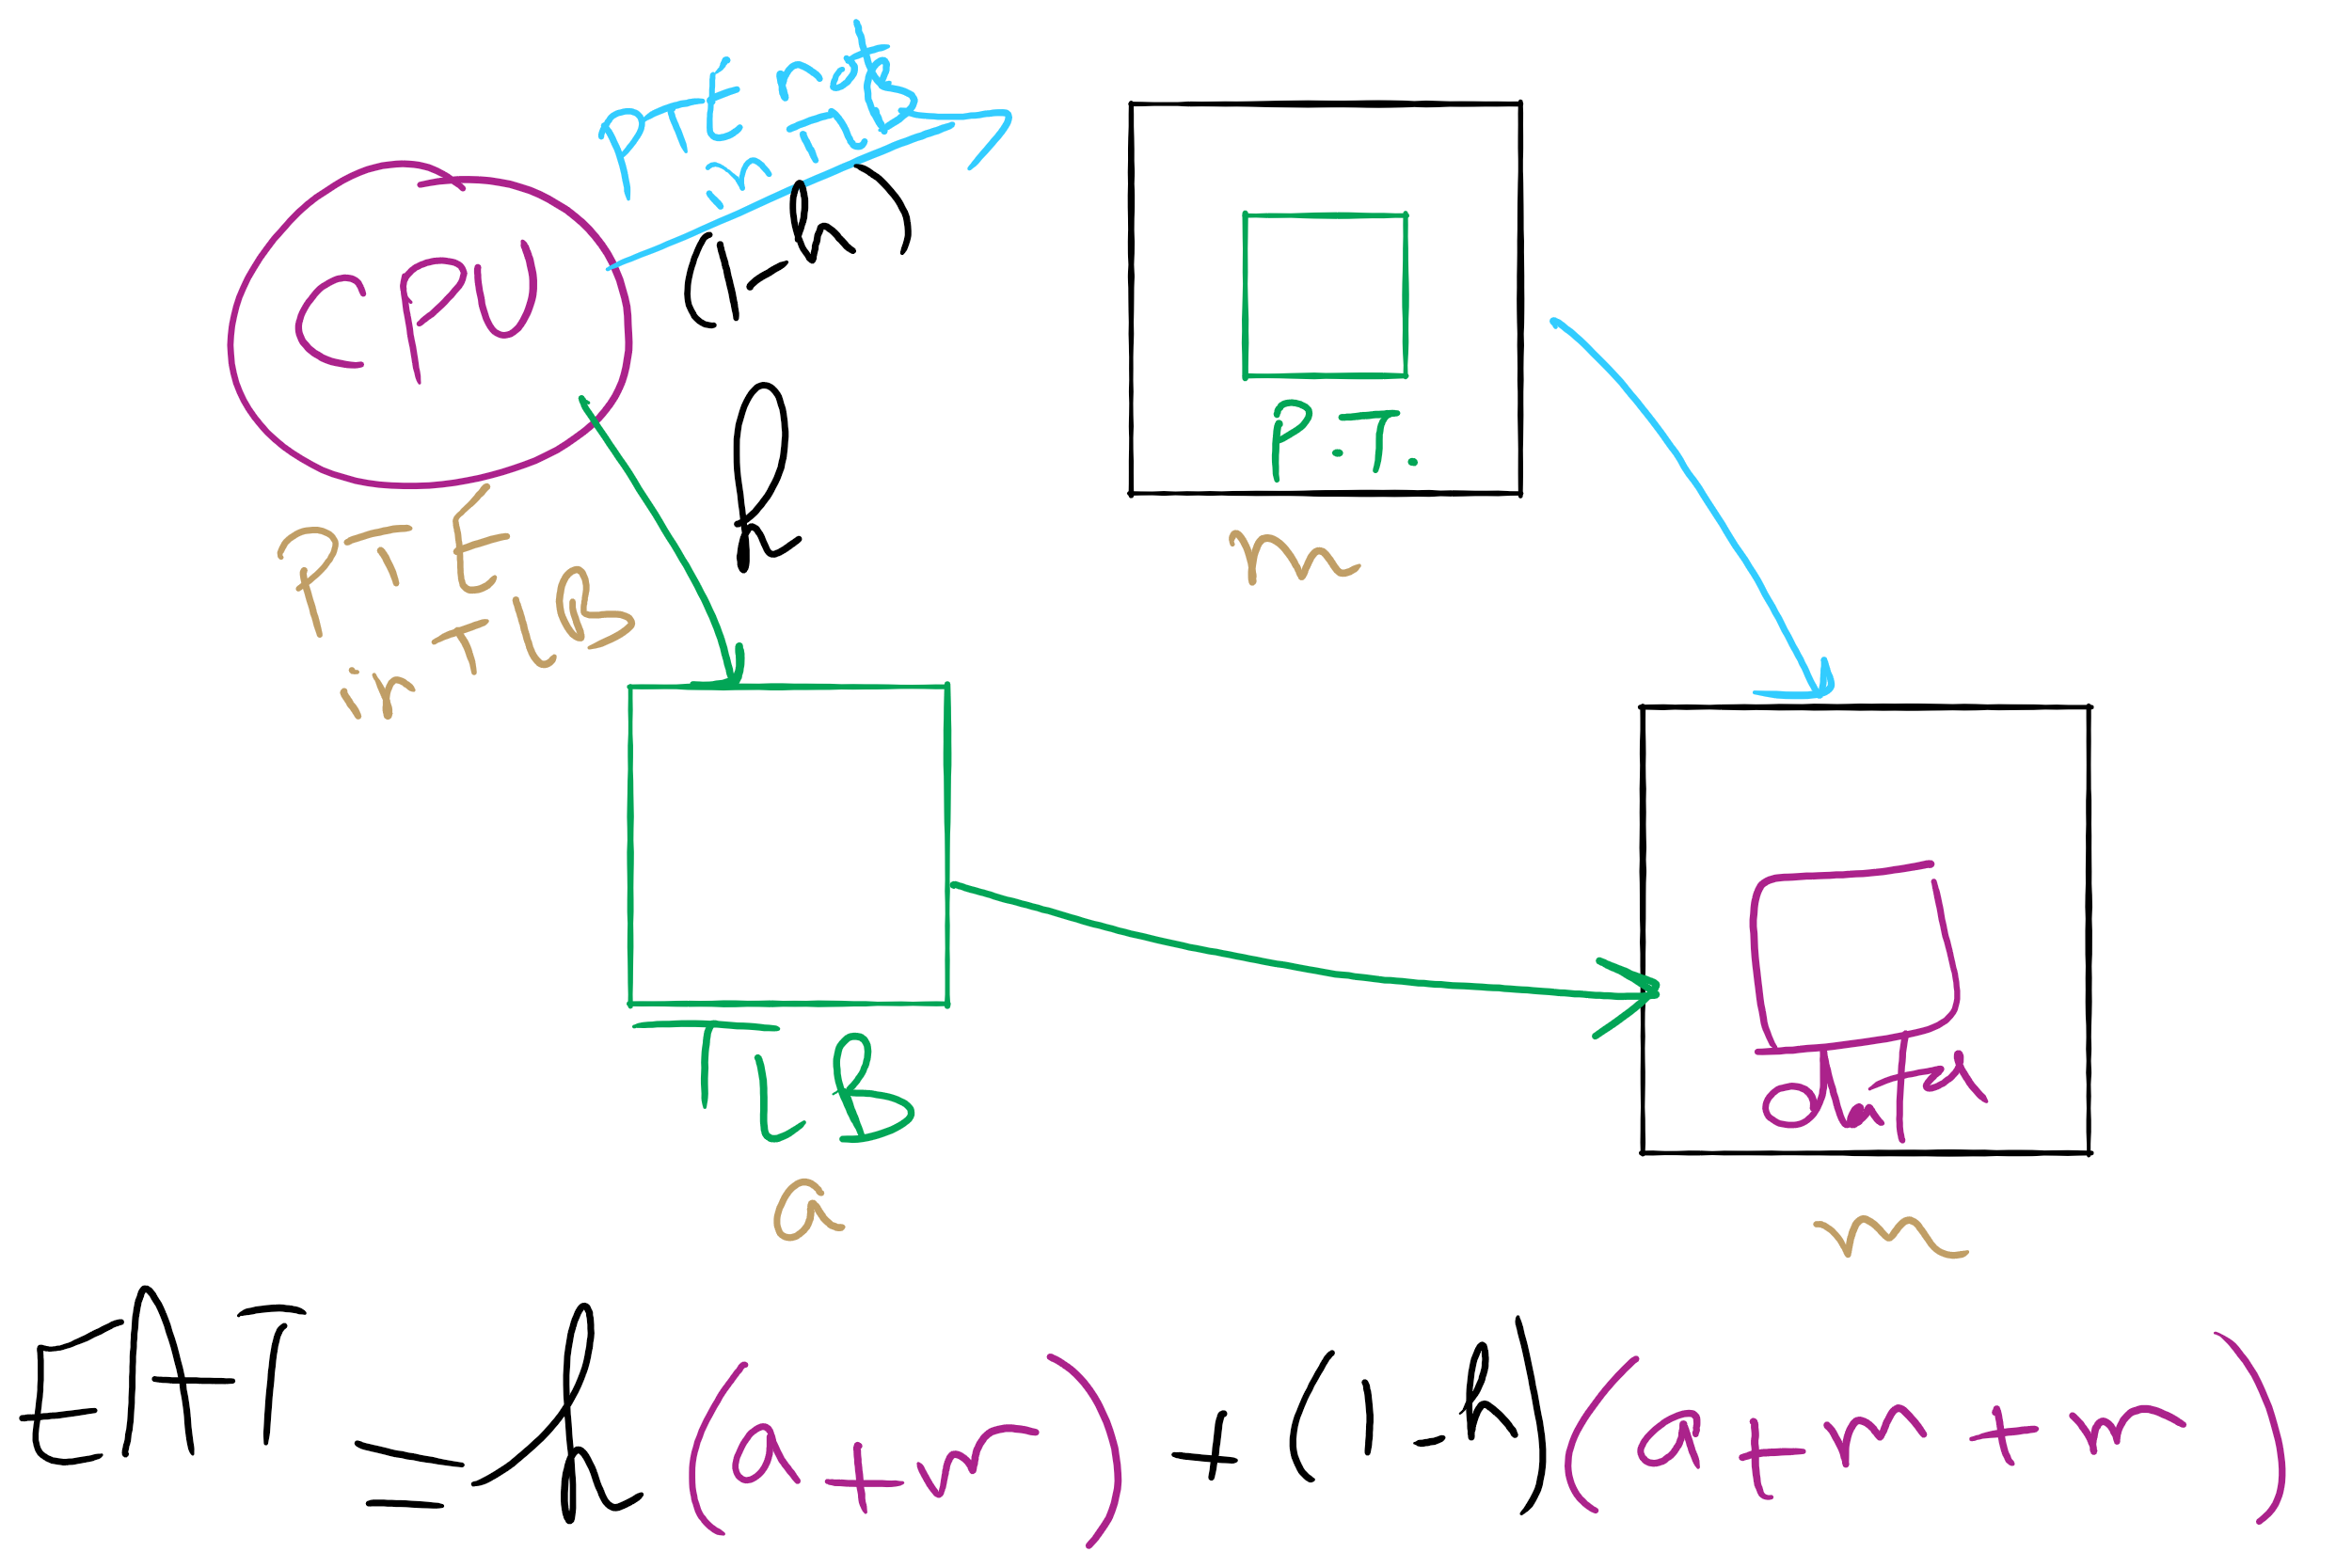
Effective Access Time

Slide 39
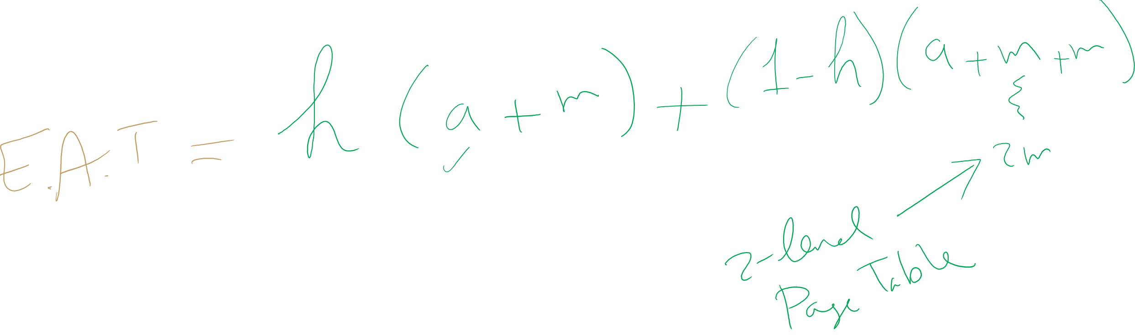
EAT Calculation

Slide 40
Solution 2: Inverted page table
Reduce page table size further: keep one entry for each frame in memory
PTE contains
Virtual address pointing to this frame
Information about the process that owns this page
Search page table by
Hashing the virtual page number and process ID
Starting at the entry corresponding to the hash result
Search until either the entry is found or a limit is reached
Page frame number is index of PTE
Improve performance by using more advanced hashing algorithms

Slide 41
Inverted page table architecture
page number
page offset
process ID
p = 19 bits
offset = 13 bits
Page frame number
0
pid
p
physical address
1
19
13
. . .
search
0
pid₀
p₀
1
pid₁
p₁
. . .
. . .
k
k
pid_{k}
p_{k}
main memory
. . .
inverted page table

Slide 42
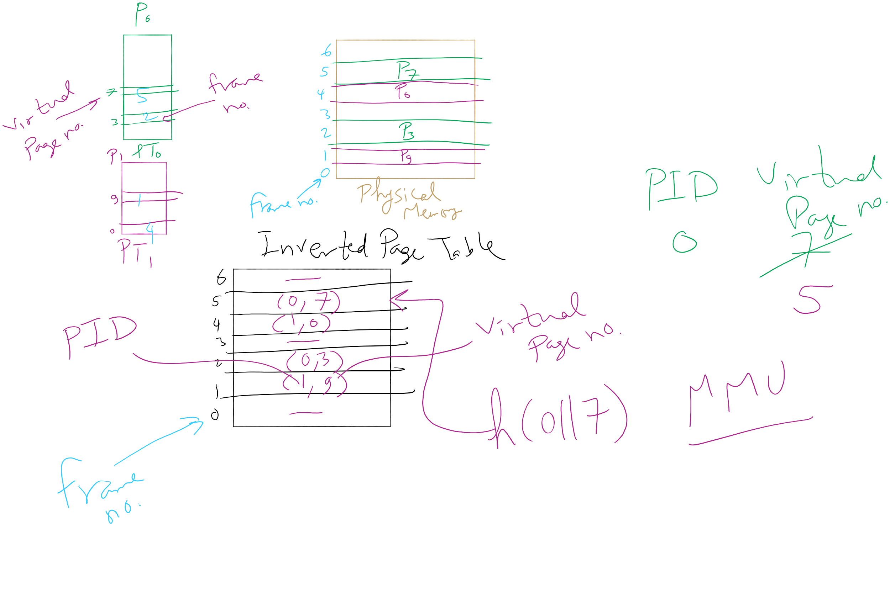
Inverted Page Table Example

Slide 43
How big should a page be?
Smaller pages have advantages
Less internal fragmentation
Better fit for various data structures, code sections
Less unused physical memory (some pages have 20 useful bytes and the rest isn’t needed currently)
Larger pages are better because
Less overhead to keep track of them
Smaller page tables
TLB can point to more memory (same number of pages, but more memory per page)
Faster paging algorithms (fewer table entries to look through)
More efficient to transfer larger pages to and from disk

Slide 44
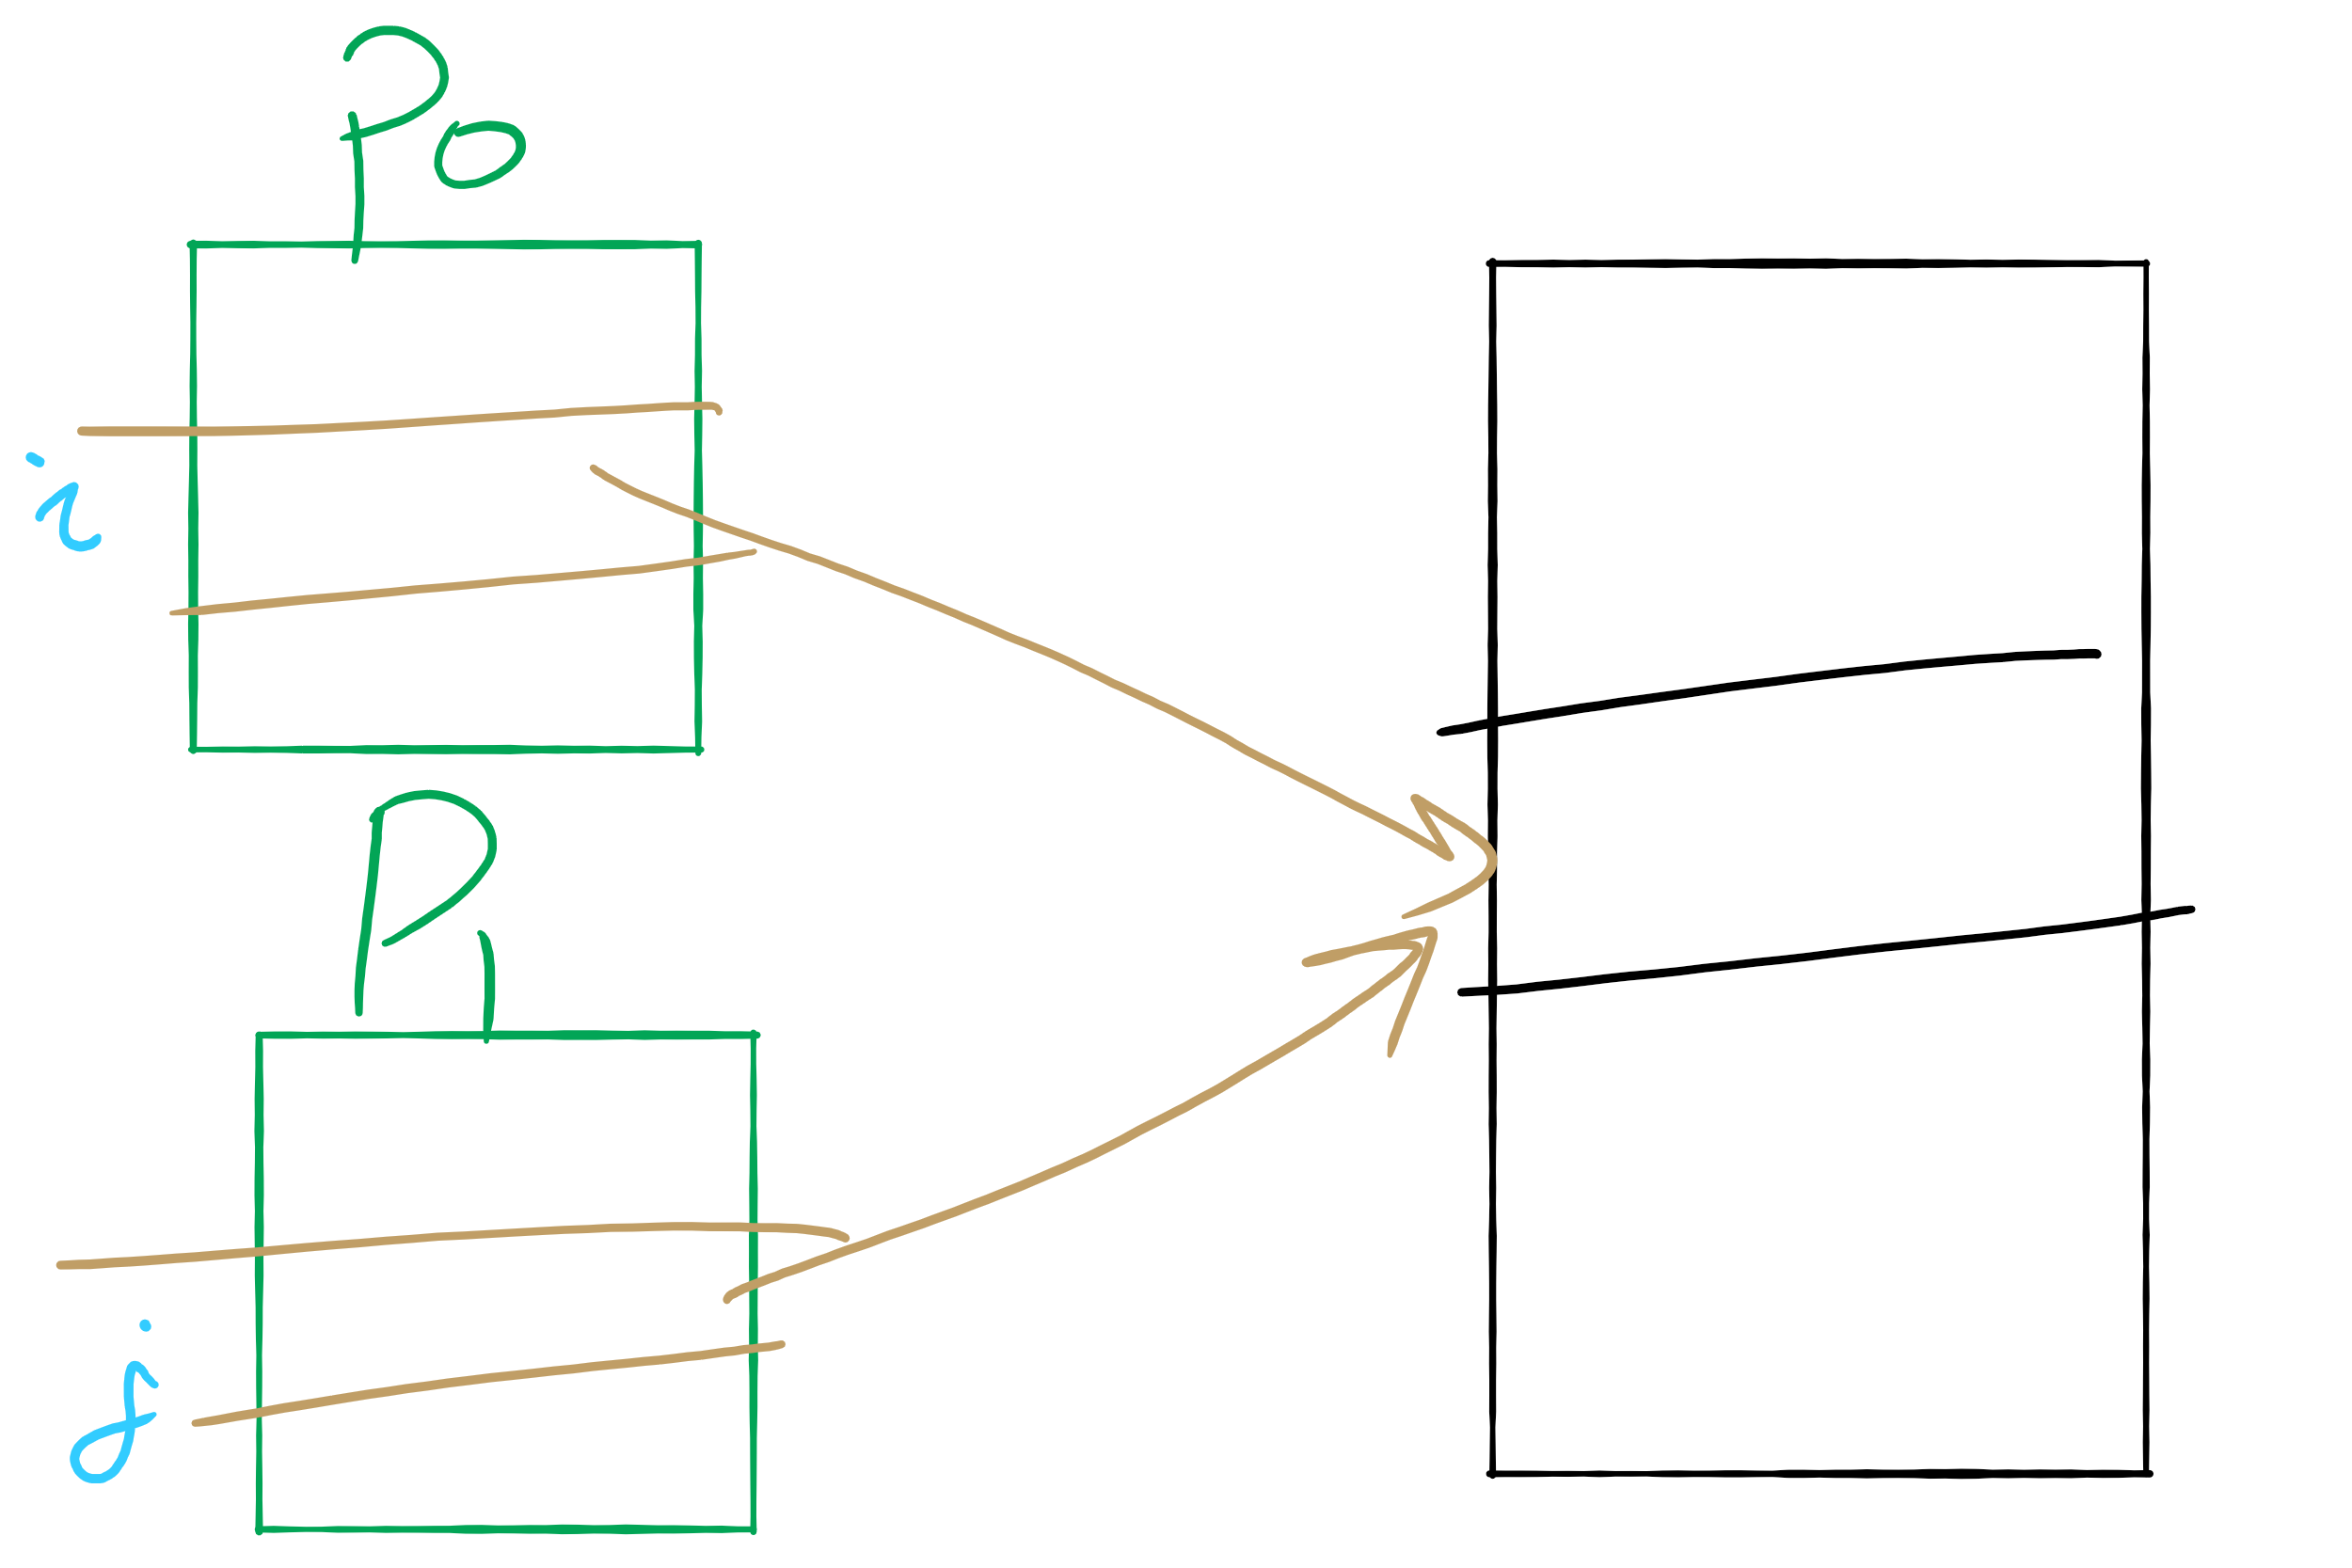
Sharing Pages

Slide 45
Sharing pages
Processes can share pages
Entries in page tables point to the same physical page frame
Easier to do with code: no problems with modification
Virtual addresses in different processes can be…
The same: easier to exchange pointers, keep data structures consistent
Different: may be easier to actually implement
Not a problem if there are only a few shared regions
Can be very difficult if many processes share regions with each other

Slide 46
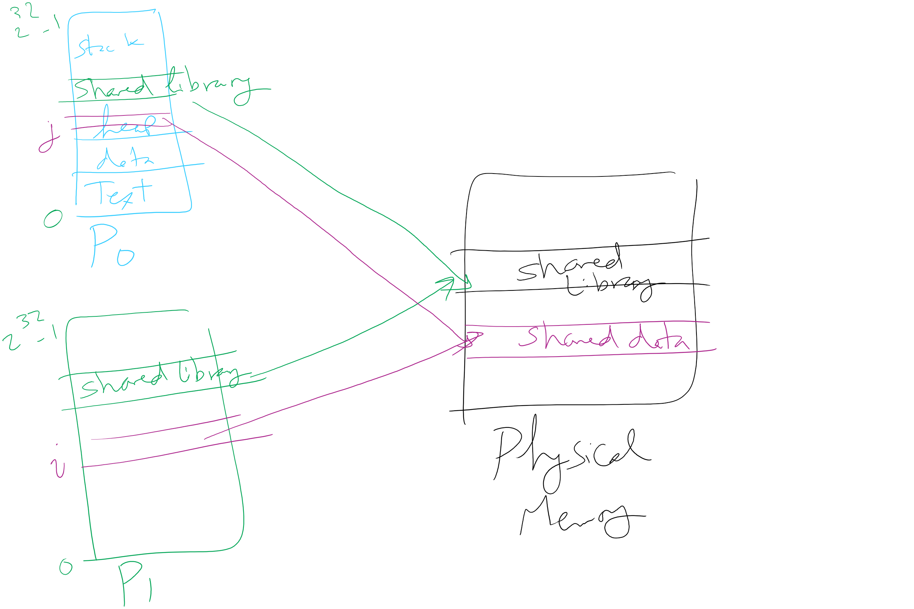
Page Sharing

Slide 47
Implementation issues
Four times when OS involved with paging
Process creation
Determine program size
Create page table
During process execution
Reset the MMU for new process
Flush the TLB (or reload it from saved state)
Page fault time
Determine virtual address causing fault
Swap target page out, needed page in
Process termination time
Release page table
Return pages to the free pool

Slide 48
How is a page fault handled?
Hardware causes a page fault
General registers saved (as on every exception)
OS determines which virtual page needed
Actual fault address in a special register
Address of faulting instruction in register
Page fault was in fetching instruction, or
Page fault was in fetching operands for instruction
OS must figure out which…
OS checks validity of address
Process killed if address was illegal
OS finds a place to put new page frame
If frame selected for replacement is dirty, write it out to disk
OS requests the new page from disk
Page tables updated
Faulting instruction backed up so it can be restarted
Faulting process scheduled
Registers restored
Program continues

Slide 49
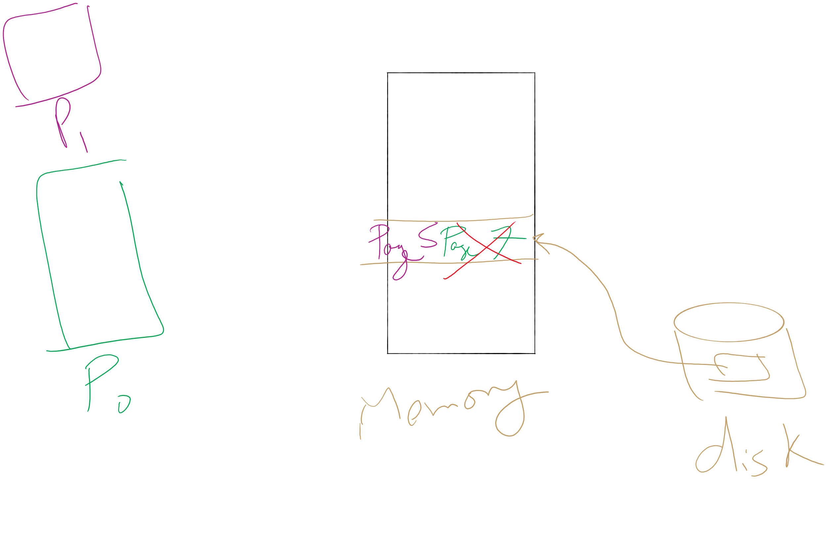
Page locking

Slide 50
Locking pages in memory
Virtual memory and I/O occasionally interact
P1 issues call for read from device into buffer
While it’s waiting for I/O, P2 runs
P2 has a page fault
P1’s I/O buffer might be chosen to be paged out
This can create a problem because an I/O device is going to write to the buffer on P1’s behalf
Solution: allow some pages to be locked into memory
Locked pages are immune from being replaced
Pages only stay locked for (relatively) short periods

Slide 51
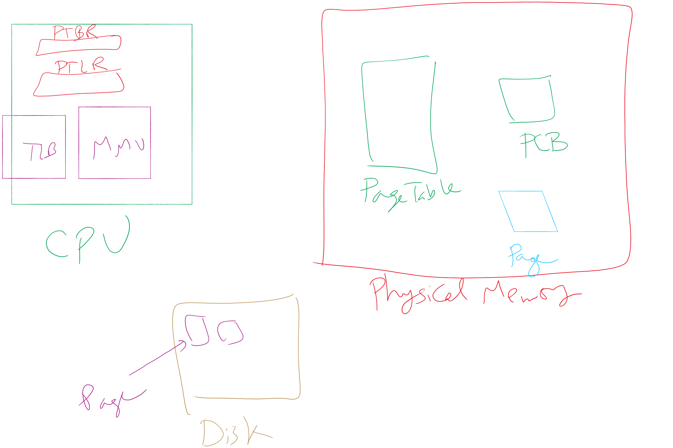
Map of MMU, TLB, Page Table, etc.

Slide 52
When are dirty pages written to disk?
On demand (when they’re replaced)
Fewest writes to disk
Slower: replacement takes twice as long (must wait for disk write and disk read)
Periodically (in the background)
Background process scans through page tables, writes out dirty pages that are pretty old
Background process also keeps a list of pages ready for replacement
Page faults handled faster: no need to find space on demand
Cleaner may use the same structures discussed earlier (clock, etc.)

Slide 53
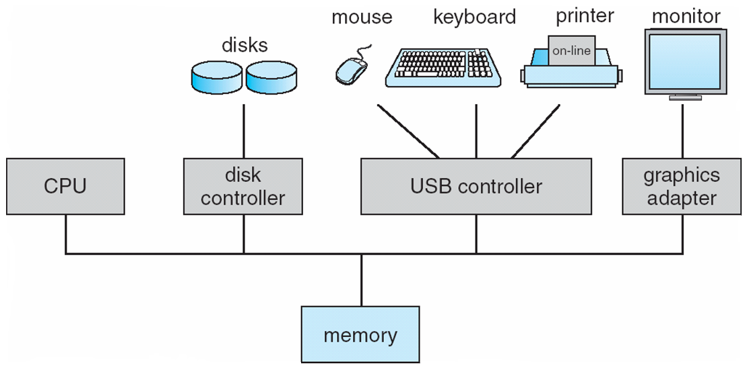
How complex is the OS’s job?
Let’s look at one of the resources managed by the OS: I/O devices

Slide 54
File system implementation issues
How are disks divided up into file systems?
How does the file system allocate blocks to files?
How are directories handled?
How does the file system manage free space?
How can the file system improve…
Performance?
Reliability?

Slide 55
Carving up the disk
Entire disk
Partition table
Master boot record
Partition 1
Partition 2
Partition 3
Partition 4
Boot block
Super block
Free space management
Index nodes
Files & directories

Slide 56
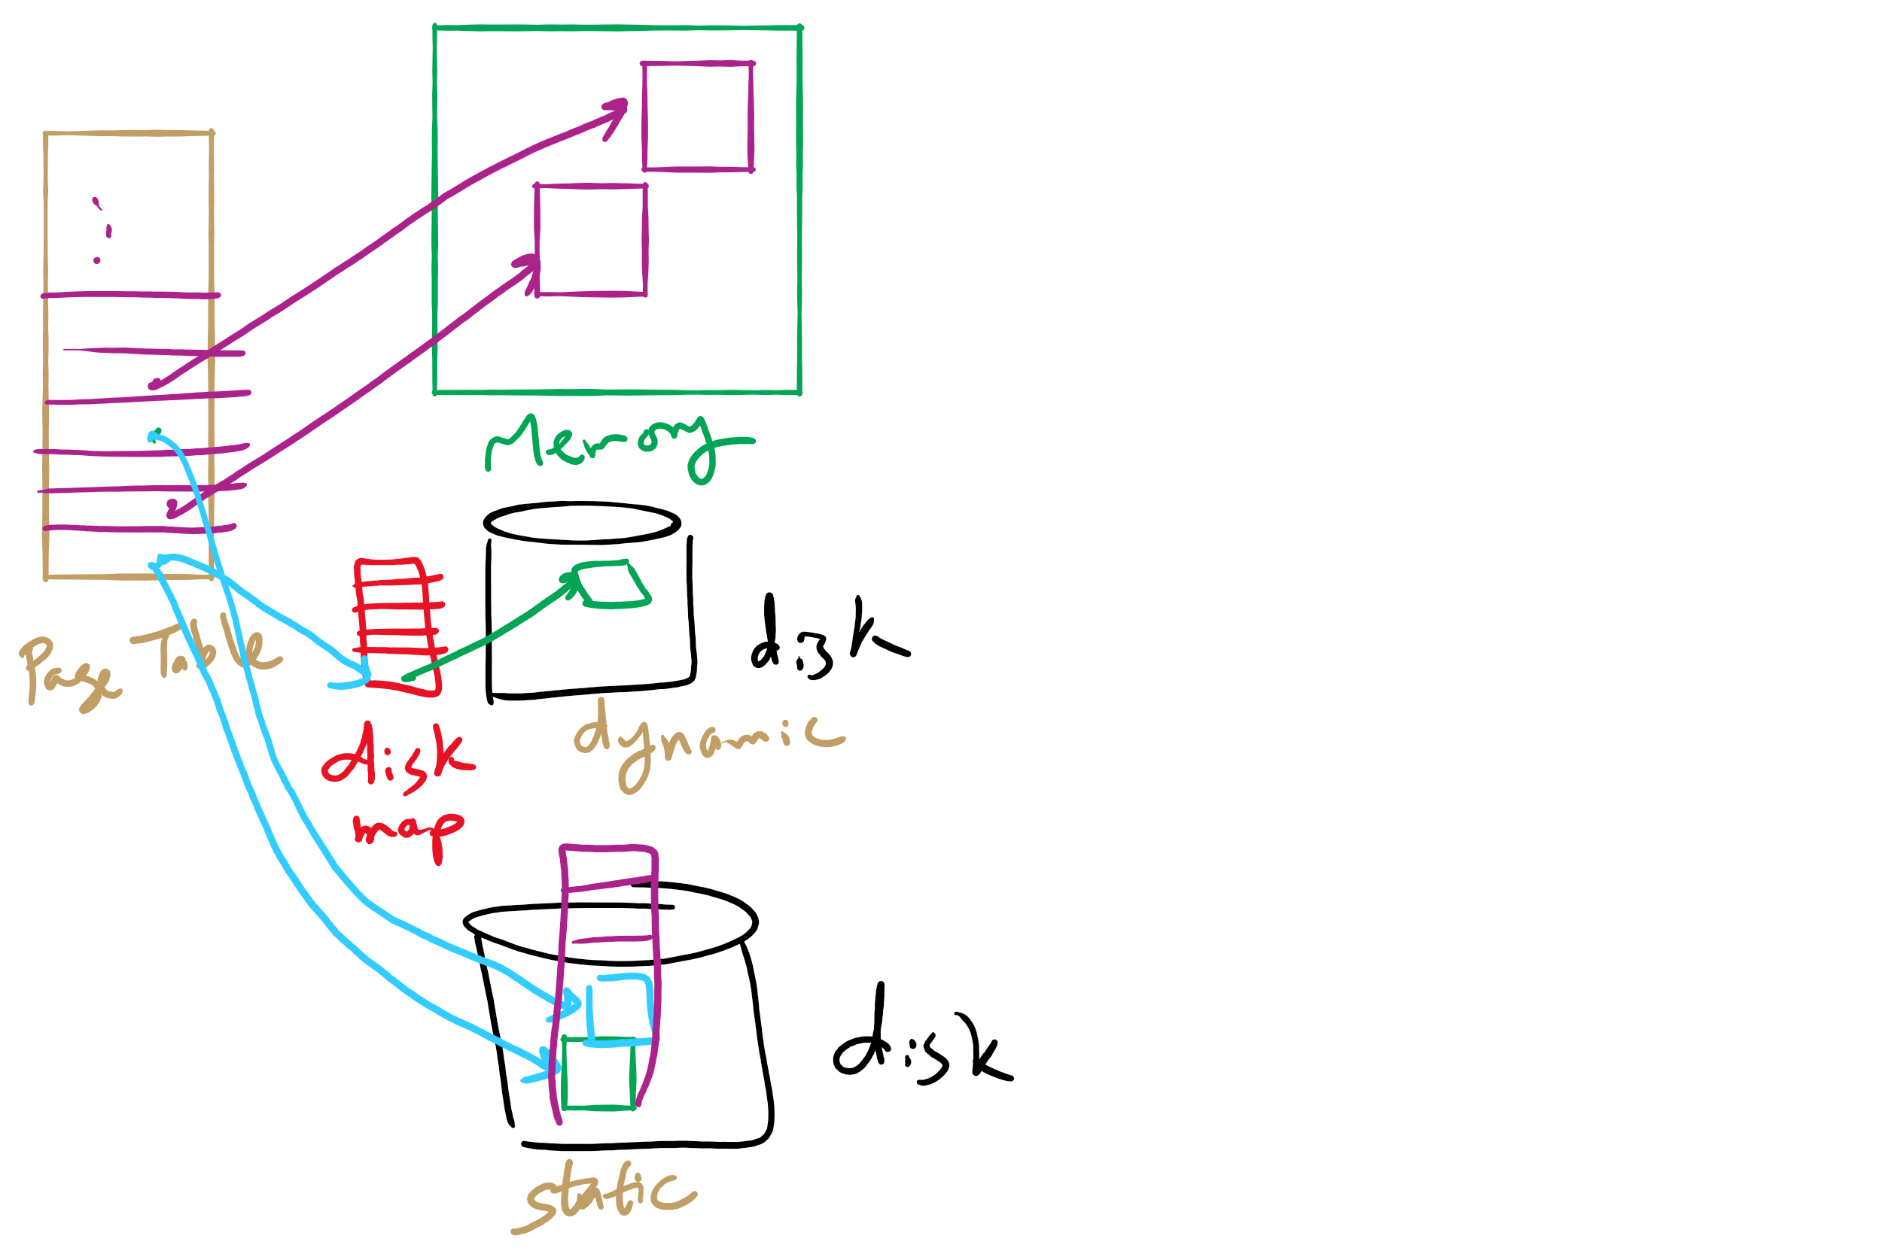
Disk Map

Slide 57
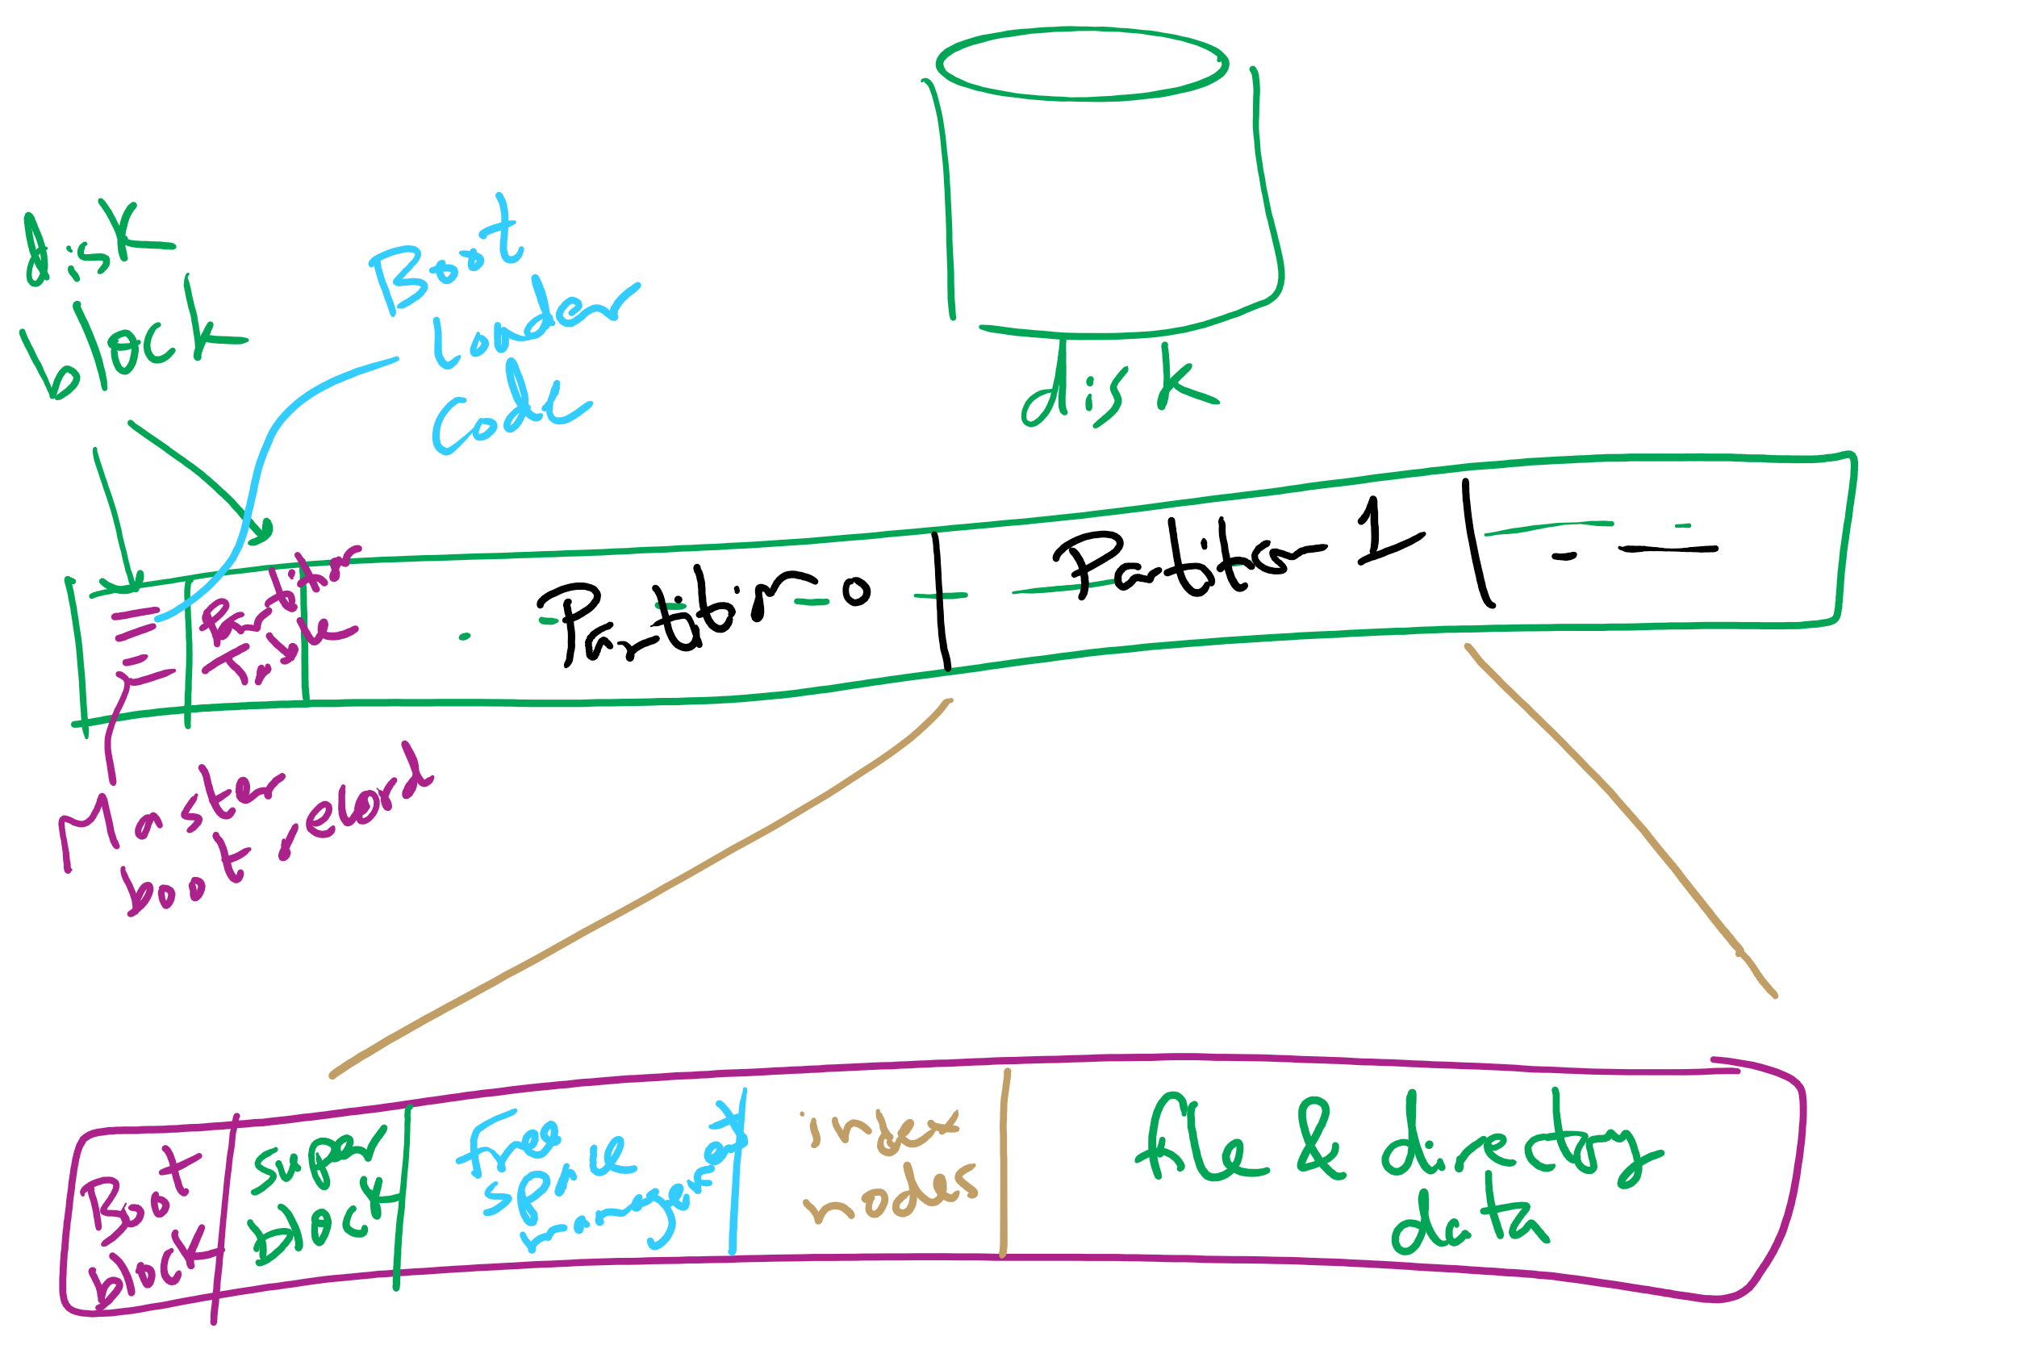
Carving Up a Disk

Slide 58
Contiguous allocation for file blocks
Contiguous allocation requires all blocks of a file to be consecutive on disk
Problem: deleting files leaves “holes”
Similar to memory allocation issues
Compacting the disk can be a very slow procedure…
A
B
C
D
E
F
A
Free
C
Free
E
F

